Slide 1

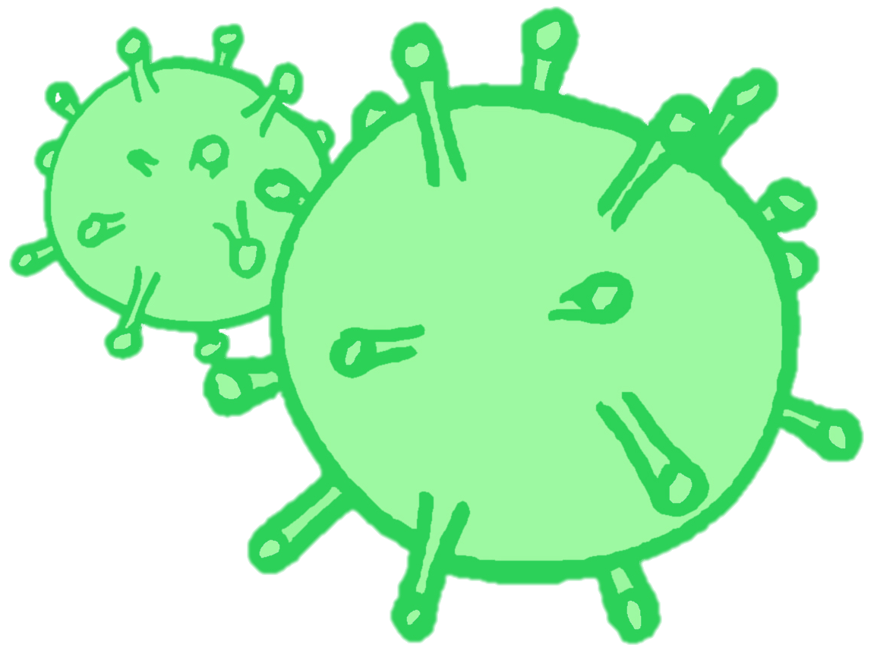
CONTRACEPTION & STI’s
Year 10 Health Lesson 9 Term 2, 2024

Slide 2

Today’s Focus
Task 3: Presentations - DUE TODAY
+ complete table as listening.

Slide 3
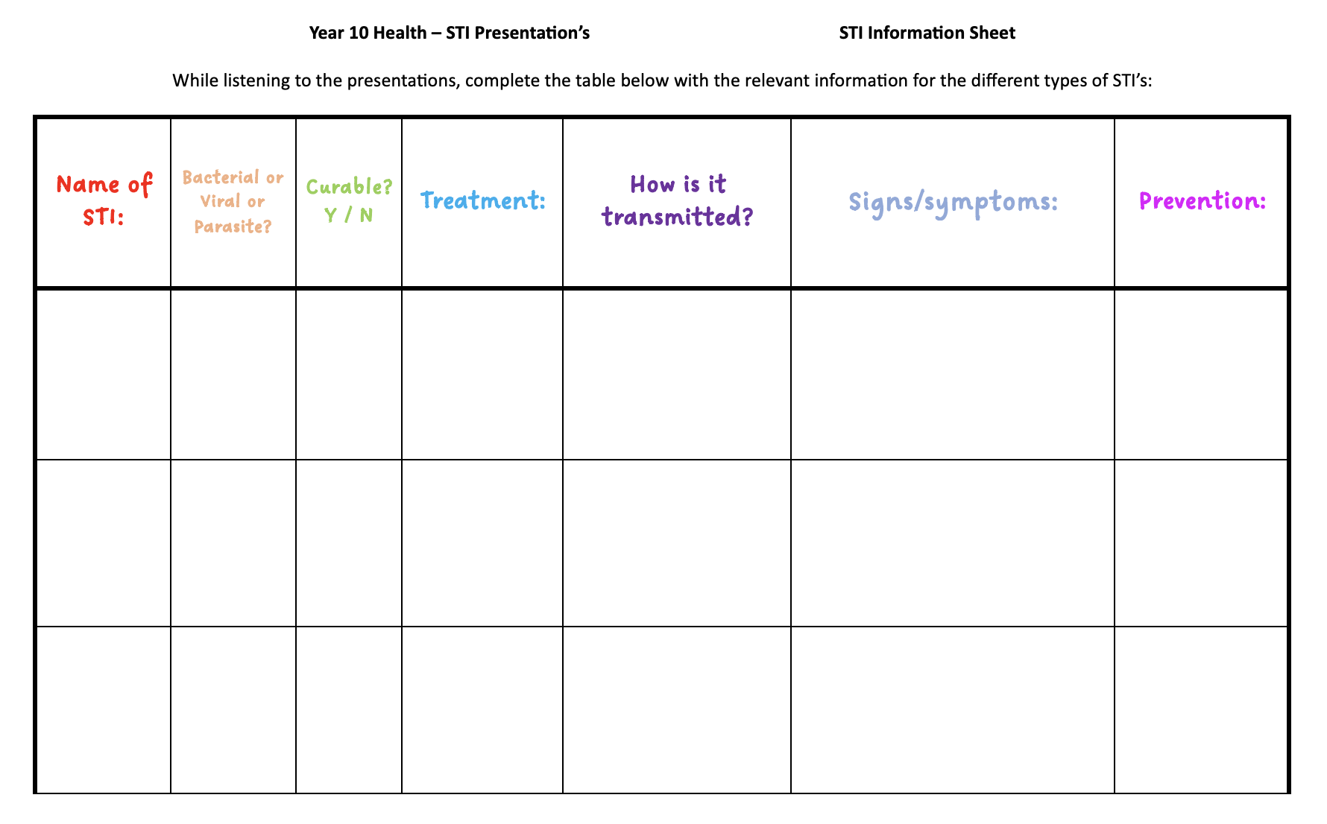
STI Presentations: (pg. 26-27)
Complete the table in your books while listening to other groups present their work.
By the end of the presentations, you will have collected information different types of STI’s.
Notes:
When students are presenting their assignments, the audience will need to complete a table about each different STI that is presented. By the end of the presentations, students will have collated information on all the different STI’s into their workbooks.

